Slide 1

The lecture will start soon at 08:30
https://unsplash.com/photos/gm3bxHin8VA
Notes:
https://unsplash.com/photos/gm3bxHin8VA

Slide 2
MySQL for Data Analytics
Lecturer: Yong Liu
Contact me at: Yong.liu@aalto.fi

Slide 3
Content
Basic information of the course
MySQL & Jobs
MySQL & Business Analytics
How to learn MySQL
Relevance to company & Basics of MySQL

Slide 4

Section 1: Basic information of the course
https://unsplash.com/photos/KdeqA3aTnBY

Slide 5
MySQL for Data Analytics
Credits: 6 cr
No. of Admitted students: 350+ [230+ in 2022]
Course homepage: - https://mycourses.aalto.fi/course/view.php?id=36995
Course assistants: - Turunen Emmi (emmi.a.turunen@aalto.fi) - Sun Jiajun (jiajun.sun@aalto.fi) - Lin Yanqing (yanqing.lin@aalto.fi)
In-course feedback system: - https://presemo.aalto.fi/mysql/

Slide 6
Content and Learning outcome
Course Content
This course provides students with a comprehensive overview of MySQL. MySQL commands and examples of applying MySQL to really-life business analytics are the key content. A number of databases are provided to support you in practicing the database language and skills. Hands-on sessions provide the opportunity to practice MySQL with the assistance of the lecturer.
Learning Outcome
The student taking this course learns about data management using the database language of MySQL. Students are expected to become skilful in manipulating different kinds of business data for different types of business analytics. Data manipulation and data management skills are necessary prerequisites for being able to use business analytics.

Slide 7

Eye and book icon
Extension of the course content
The materials are not relevant to the big assignment!
Read by yourself.
The materials are not relevant to the big assignment!

Slide 8
Connection to Other Courses/Jobs
Capstone: Business Intelligence (Power BI, Tableau)
Recommended course before
Business analyst
MySQL for Data Analytics
Data Scientist
Data Science for Business (Python/R)
Recommended course before

Slide 9
MySQL & Career Development
You will likely take an important role in enterprises a few years after graduation.
Data literacy: A must-have skill for future managers or business leaders
Data literacy is the ability to access, read, understand, create, and communicate data as information and use data as a resource for decision-making.

Slide 10

Data Literacy and Being A Manager
A lack of data literacy among enterprise employees has become a key bottleneck for enterprise making a good use of their data!
“Poor data literacy is ranked as the second-biggest internal roadblock to the success of the CDO’s office, according to the Gartner Annual Chief Data Officer Survey. By 2023, data literacy will become essential in driving business value, demonstrated by its formal inclusion in over 80% of data and analytics strategies and change management programs.”
https://commons.wikimedia.org/wiki/File:Too_Busy_To_Improve_-_Performance_Management_-_Square_Wheels.png
Suggested after-course reading:
A Data and Analytics Leader's Guide to Data Literacy
Link: https://www.gartner.com/smarterwithgartner/a-data-and-analytics-leaders-guide-to-data-literacy

Slide 11
Schedule (7 lectures + 5 Exercises)
Week | First Sessions | Time | Second Sessions | Time
1 | Wed 07.09.2021 | 08:30-10:00 | Wed 07.09.2021 | 10:15-12:00
2 | Wed 14.09.2021 | 08:30-10:00 | Wed 14.09.2021 | 10:15-12:00
3 | Wed 21.09.2021 | 08:30-10:00 | Wed 21.09.2021 | 10:15-12:00
4 | Wed 28.10.2021 | 08:30-10:00 | Wed 28.10.2021 | 10:15-12:00
5 | Wed 05.10.2021 | 08:30-10:00 | Wed 05.10.2021 | 10:15-12:00
6 | Wed 12.10.2021 | 08:30-10:00 | Wed 12.10.2021 | 10:15-12:00
Blue background: lecture sessions (N = 7)
Yellow background: hands-on sessions (N = 5)
Course period: September 7 to October 12
Both lecture and hands-on sessions will be delivered on Zoom.
Zoom link: https://aalto.zoom.us/j/5138969960
Lecture sessions (not hands-on sessions) will be video-recorded.
Hands-on Session Materials: You can simply start to work on the hands-on materials after the hands-on session starts – we have NO ‘opening speech’.

Slide 12


Hands-on Session: Feedbacks & Changes
Highly positive
Previous Feedback on the strategy:
“Exercise session” right after “Lecture session”
Before COVID-19 Pandemic/on-site teaching
During COVID-19 Pandemic/online teaching
Half positive & Half negative
Reasons for Negative Feedback on the strategy:
Need to work, cook or do something else after the lecture. Thus, cannot attend the hands-on session right after the lecture.
Uncomfortableness to ask questions/share screen in front of others, or privacy concerns.
Cannot participate in the lecture or hands-on session due to e.g. work.
Changes and Proposed Solutions
Protection of Privacy
Use of breakout room.
Instruction for the hands-on session in MyCourse.
2. Hands-on sessions as a service
If you need help, please send an email to the lecturer or teaching assistants. We will reply to you or arrange a zoom meeting to support you asap.
3. Additional hands-on session
Wed 14.09.2021 between 14:00 and 15:30
Zoom: https://aalto.zoom.us/j/5138969960
https://www.maxpixel.net/Thumbs-Up-Smiley-Face-Face-Smiley-Happy-Emoji-4007573
https://www.maxpixel.net/Message-Yellow-Emoji-Upset-Sad-Face-Bored-5843434

Slide 13
Performance Evaluation / Grading method
Assignment evaluation (100%)
One big assignment for individuals (no teamwork!)
Grading schema:
Grade (scale:1-100) | Final Grade (scale: 1-5)
> 90 (not including 90) | 5
81 - 90 (not including 80) | 4
71 - 80 (not including 70) | 3
61 - 70 (not including 60) | 2
51 - 60 (not including 50) | 1
<= 50 | Not pass

Slide 14

Preparation for Big Assignment
You will have one-month time to do the big assignment after the last lecture of the course.
Nonetheless, you could do some tasks of the assignment already after a few weeks of study.
Practice is very important! (like getting a driving license)

Slide 15
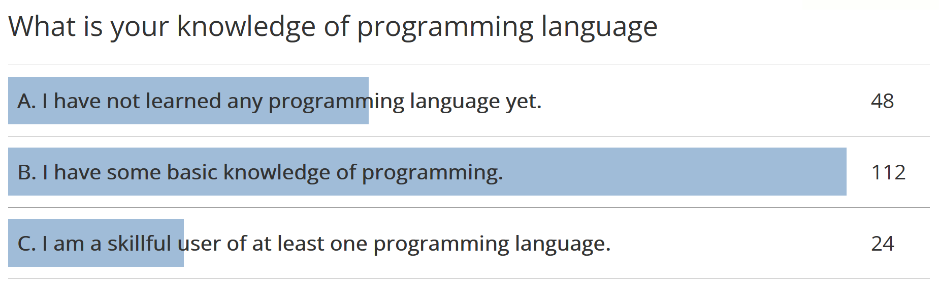
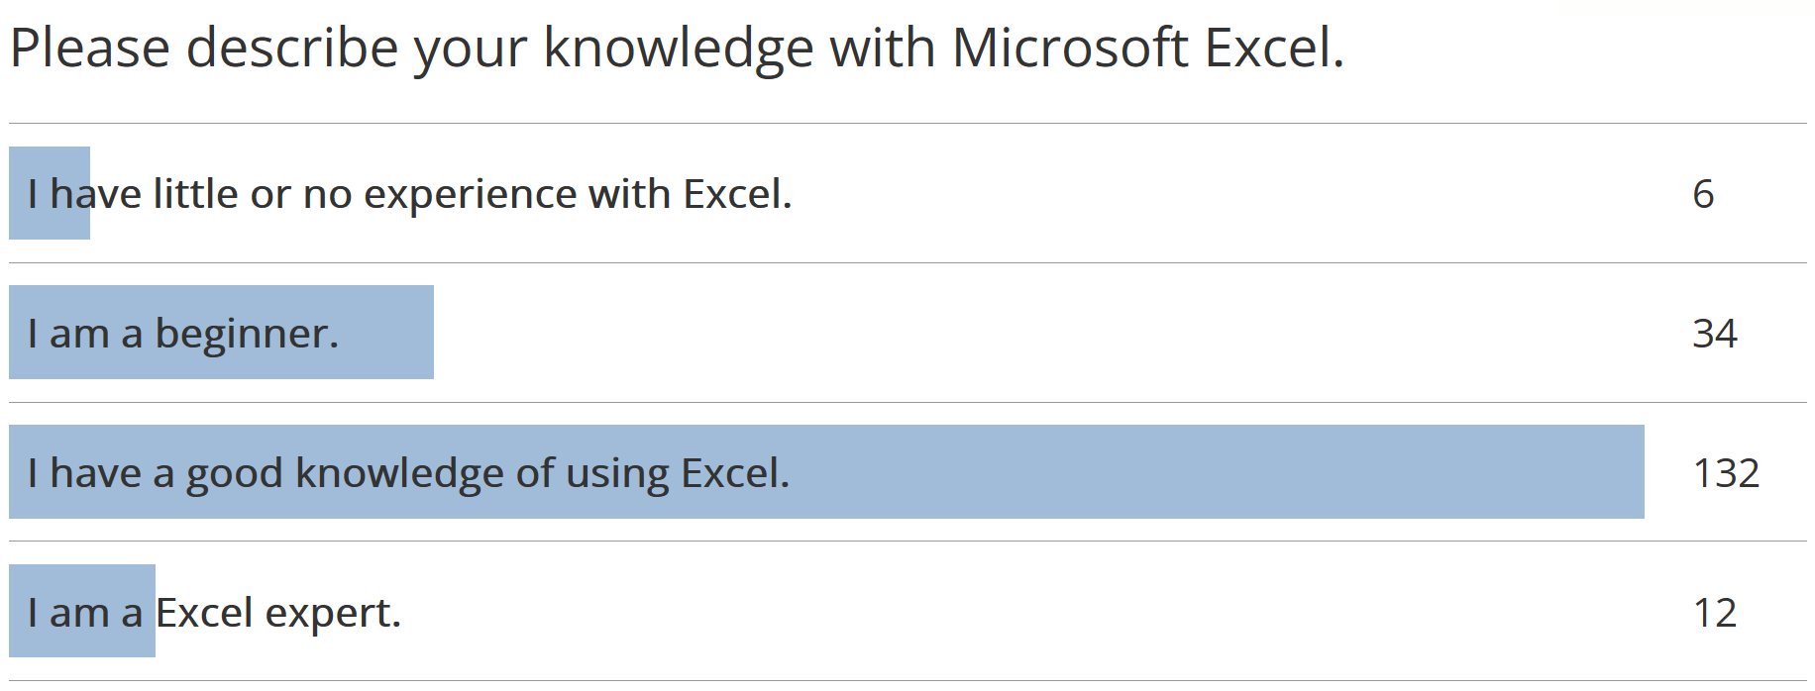
Settings of the course
1. The course aims at helping beginners.
2. Students without programming background can attend the course.

Slide 16
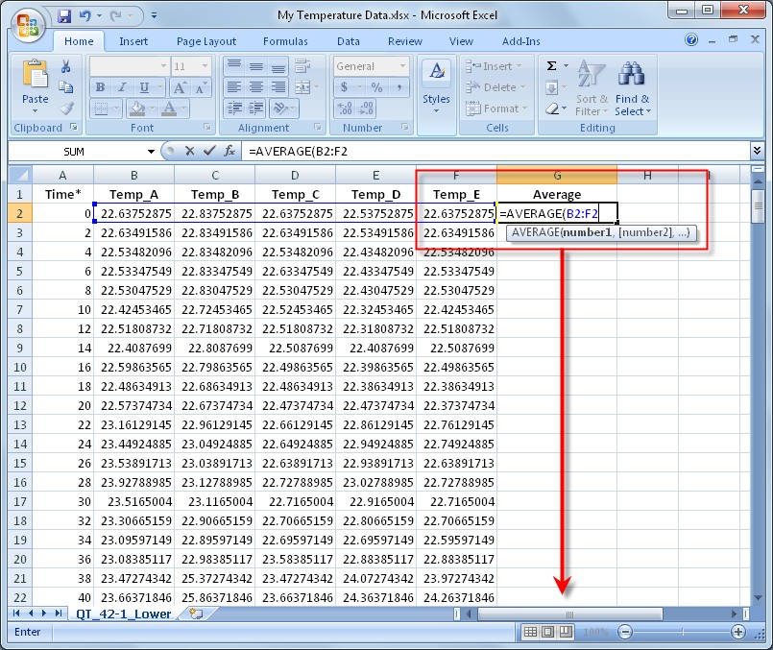
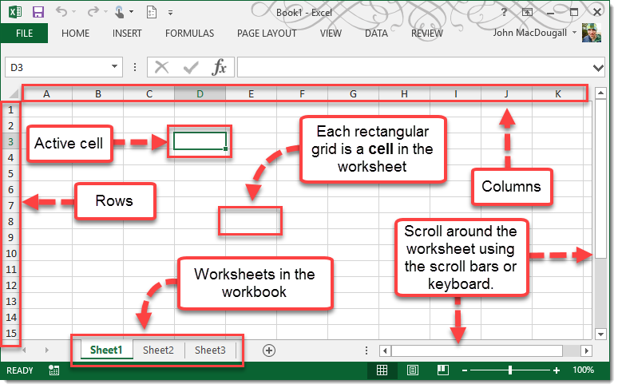
https://www.howtoexcel.org/tutorials/worksheet-area/
https://www.ni.com/fi-fi/innovations/white-papers/10/moving-beyond-microsoft-excel-for-measurement-data-analysis-and-.html

Slide 17
Online Materials for Learning MySQL
Course book
Pratt, P.J. and Last, M.Z. (2005). A guide to MySQL, Thomson.
MySQL 8.0 Reference Manual
http://dev.mysql.com/doc/refman/8.0/en/index.html
Inquiry on how to use MySQL
http://stackoverflow.com/
Google is always a friend!

Slide 18

Section 2. MySQL & Jobs
https://www.pexels.com/photo/photo-of-people-near-wooden-table-3184418/
Notes:
From this section, we will talk about the usefulness of the MySQL in terms of job hunting.

Slide 19
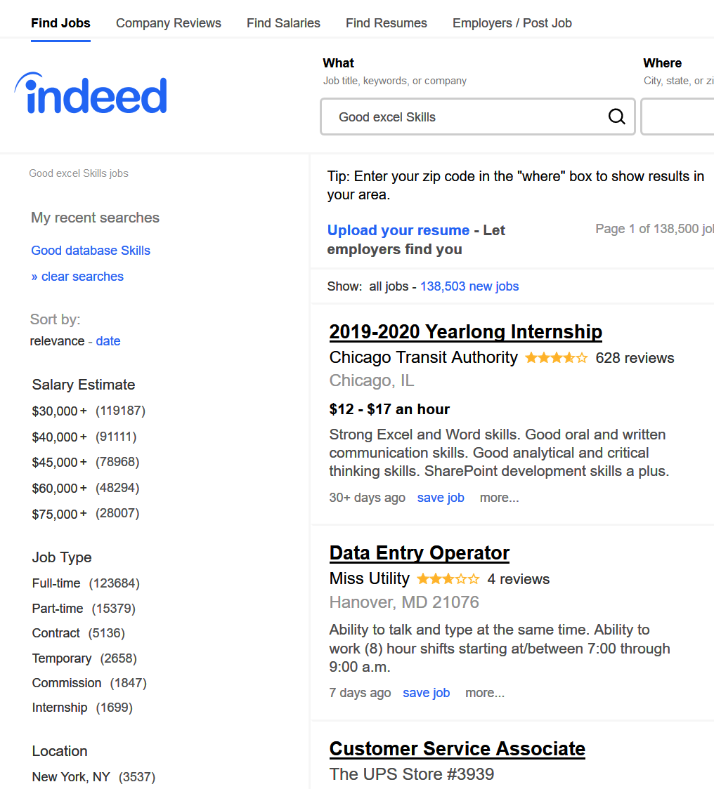
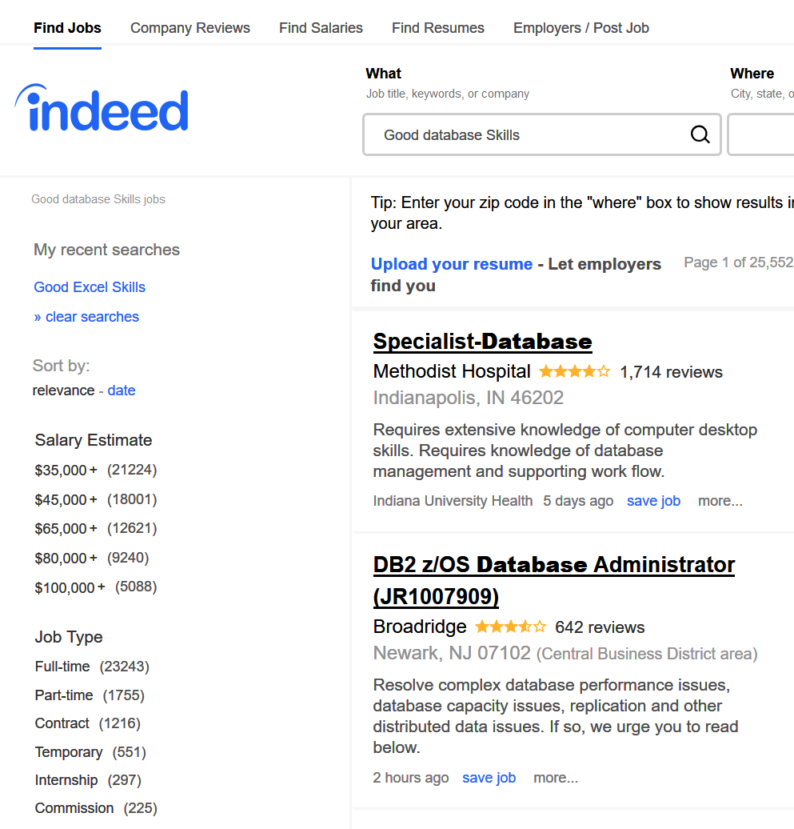
Database as a useful skill (salary)
Information retrieved on August 7, 2019

Slide 20
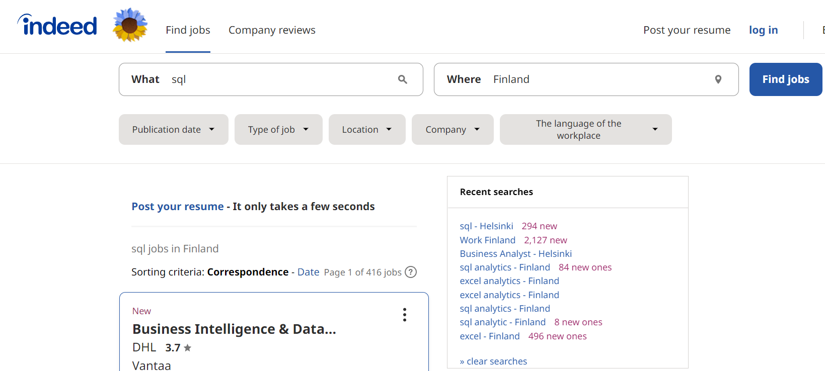
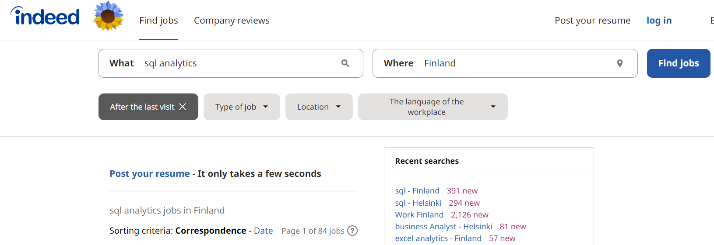
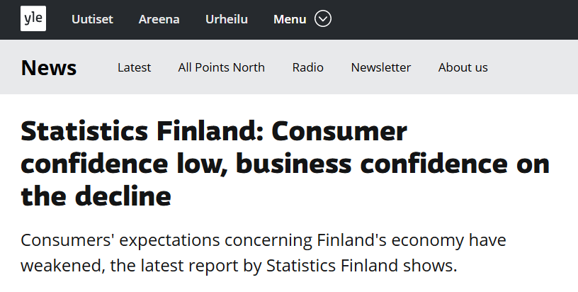
Results of search for SQL related jobs in Finland
487 in 2021
Information retrieved on 26-08-2022
83 in 2021
https://yle.fi/news/3-12598410, Date: 29.8.2022 11:01
Notes:
This slide show the results of searching sql related jobs in Finland this year on August 18 when I was preparing for the course. As you can see, there are over 487 jobs available at that day for those with a sql skill. Especially for those using SQL for doing analytics related job, there are 83 positions. I guess we will obtain more results, if we use Finnish word of analytics to do the search. As we know job slots are normally fulfilled in a couple of months, we could actually expect more relevant positions throughout the year.

Slide 21

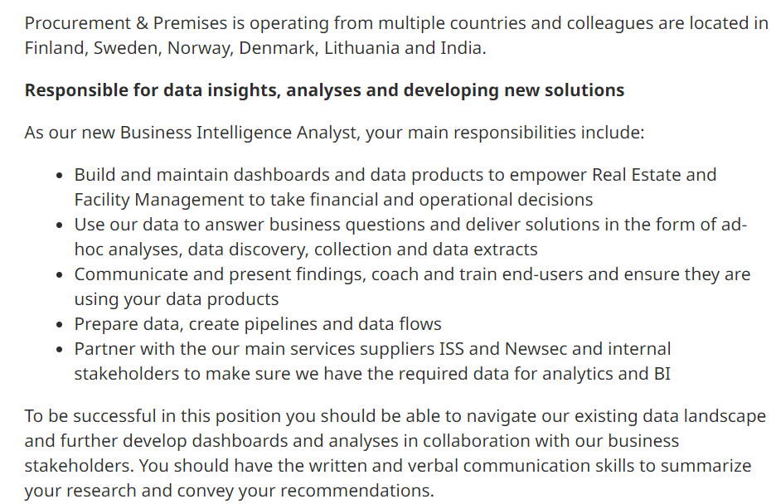
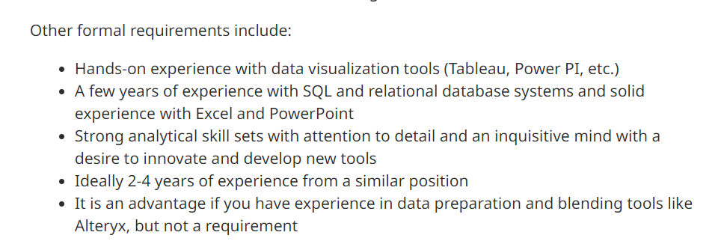
Information retrieved on 26-08-2022
Notes:
https://fi.indeed.com/viewjob?jk=cbfb99b503b6e4f4&tk=1gbcnrjucsu1v800&from=serp&vjs=3

Slide 22

Section 3. MySQL & Business Analytics
https://www.pexels.com/photo/black-and-gray-laptop-on-black-sectional-couch-577210/
Notes:
In this section, we will talk about the role of MySQL in the data life cycle or in a analytic project from the view of data manipulation

Slide 23


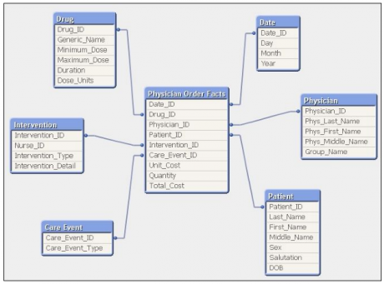
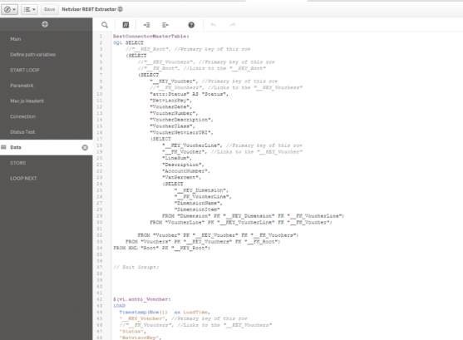
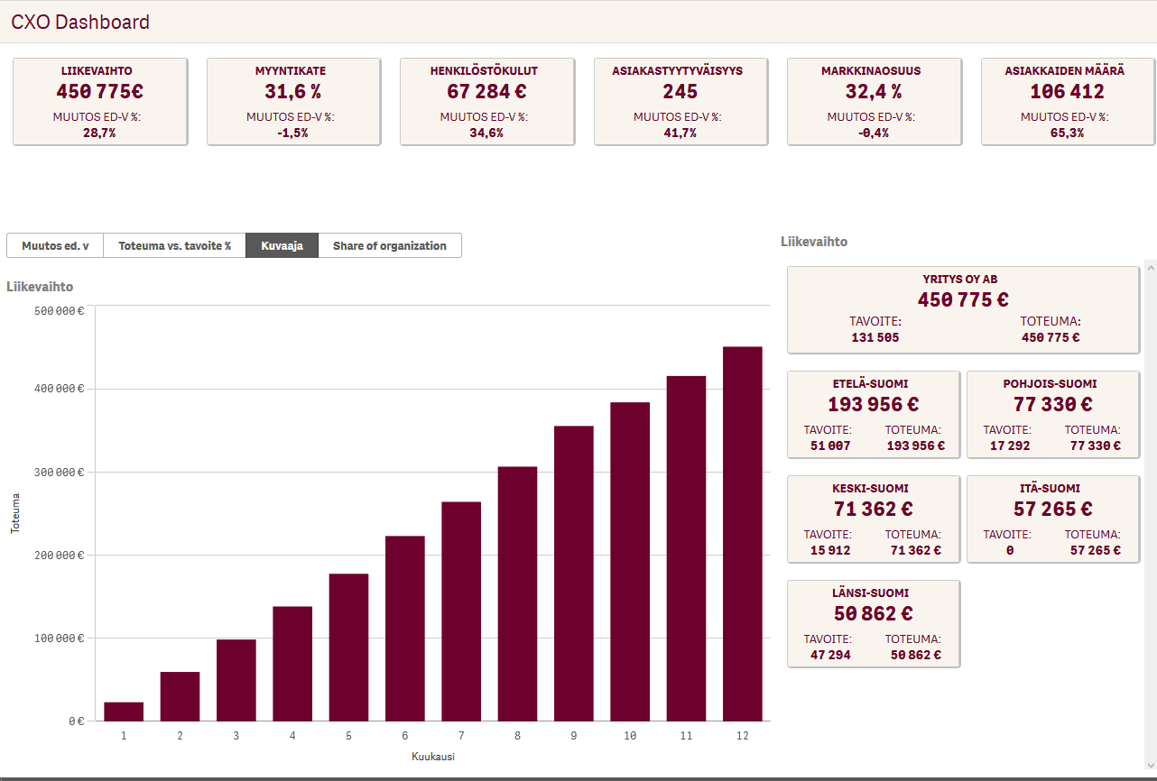
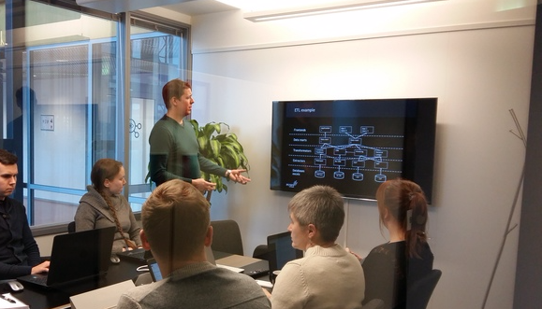
A day in the life of Consultant
Data transformation and modelling ~ 70 %
Tuukka Pesonen
Jesse Rajala
Front end development
~ 20 %
Meetings ~ 10 %
Breakdown of working hours
Notes:
Probably, you consider such data manipulation steps are easy and could be done in a short period of time. But in reality, such data manipulation or transformation works occupied lots of time for analysts. For instance, this is a slide from our alumni, Tuukka and Jesse. They are business consultant at Ecraft. Ecraft is often a sponsors of different student events of our department. They show in a guest lecture last year that in their daily work, they would have to spend about 70% of time to do data transformation and modelling.

Slide 24
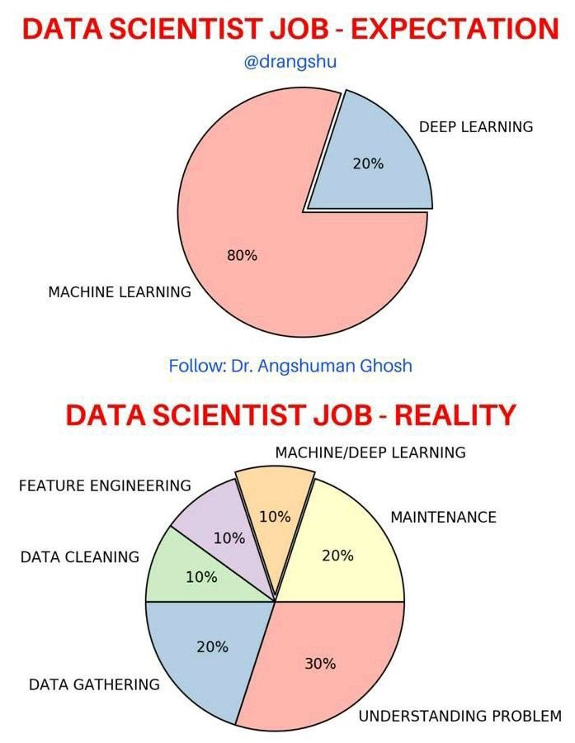
A day in the life of a data scientist
https://twitter.com/michael_warren/status/1346281975594721280

Slide 25





People Working with Database
Database as a data farm
Database developer as the builder of a data farm
Database manager as guard of the data farm
Decision maker of company as the customer to serve
MySQL analyst as a chief who makes salad using vegetable obtained from the data farm
https://unsplash.com/photos/53ark9ceU8A
https://www.pngitem.com/middle/wRhiwh_ruler-clipart-horizontal-construction-worker-cartoon-free-hd/
https://freesvg.org/city-guardian
Notes:
While in the previous discussion, we have mainly talked about MySQL from a view of data analytics. But you should notice that not all MySQL related positions are for analytics. We have other positions approaching MySQL with a different requirements. For instance,

Slide 26




An Analytical Mind/Data Literacy?
Why it is important?
How to obtain an analytic mind?
You will understand what is an analytic mind via doing the big assignment.
More organized data
SQL
Data
SQL + analytic mind
Business insights
https://www.lego.com/fi-fi/product/bugatti-chiron-42083?ef_id=CjwKCAjw19z6BRAYEiwAmo64LcID7ZJkOsd7djGKNf0ISlSGGwKZYP2Rub3LGal_hJQmEgP4HPk_ZhoCx-cQAvD_BwE:G:s&s_kwcid=AL!933!3!433398418503!!!g!296303633664!&cmp=KAC-INI-GOOGEU-
Notes:
In my understanding, a very different requirement for using MySQL for data analytics is an analytical mind. If you use SQL for some sorting jobs, you may have a more organized data. But for being an analyst, you have to be more creative. If we consider data as a collection of lego bricks, business insights can be obtained after you creatively using the data. This is an very important capability, you will gain more understanding after completing the big assignment.

Slide 27

Section 4. How to learn MySQL
https://unsplash.com/photos/505eectW54k
Notes:
In this section, we will briefly talk about how to learn MySQL

Slide 28
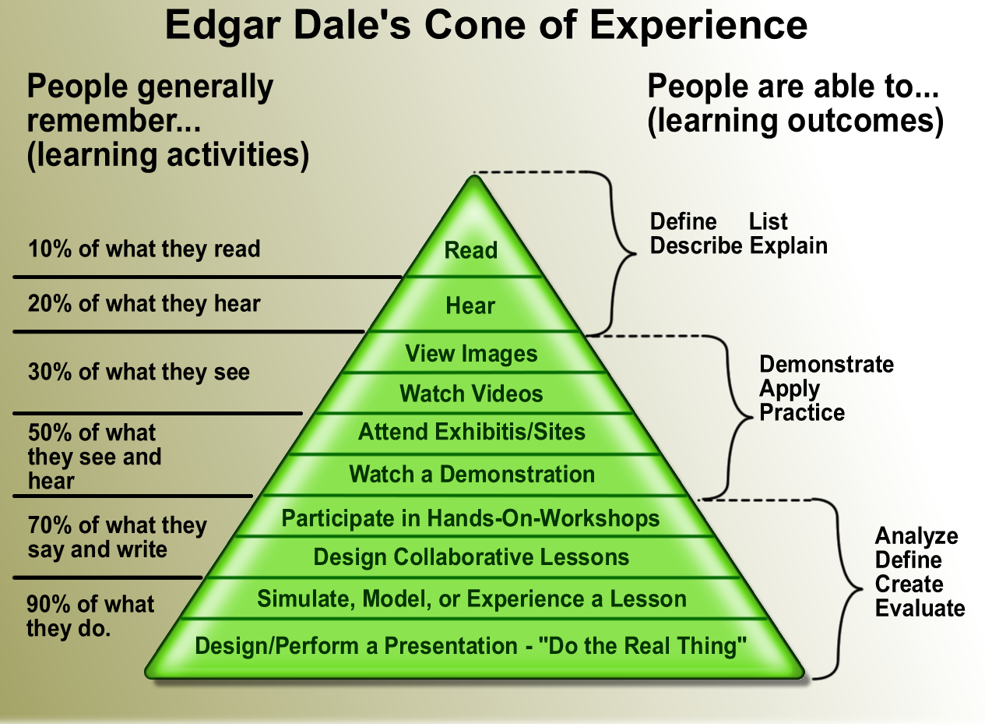
http://upload.wikimedia.org/wikipedia/en/2/29/Cone_of_learning_export_11x17.png
Notes:
This pyramid shows how your learning can be more effective by taking particular activities. As we are doing a programing course, it is highly important that you participate in practicing the software. By attending the lecture, you might remember 50% of the information delivered to you, but by participating in hands-on session, you could remember about 70%, but for using the language to solve problem through your own thinking, you will remember about 90% of what you do.

Slide 29
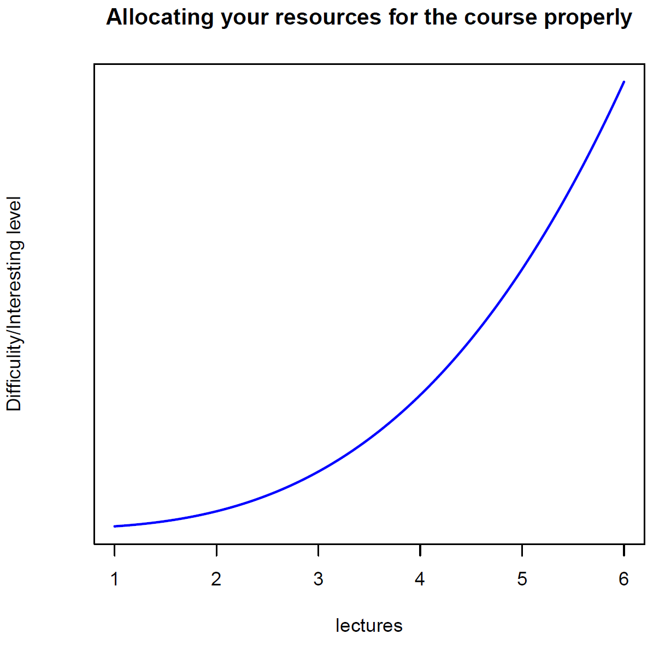
MySQL as a language
The first few lectures demand more memorization work, and very limited critical thinking.
The last few lectures demand more critical thinking, in addition to some memorization work.
Articles
90% thinking + 10% coding
50% thinking + 50% coding
Sentences
Advices:
- Keep pace with the lectures. Otherwise, you will find the course tremendously difficult in the last few lectures, if you do not get familiar with basic MySQL vocabulary.
10% thinking + 90% coding
Words
MySQL as a language: Words → Sentences → Articles
Notes:
The right way to learn MySQL is to learn it as a language, as the easiest langauge in the world, that you would learn by taking only 24 hours of lectures and hands-on sessions. In this process, you will first learn some basic vocabulary like words, then you combined more words to be sentences. Finally, you will be able to many sentence to constitute a article to solve a specific business problem.

Slide 30
In order to be benefited!
Practicing the software is the only way to gain the skills!
Using MySQL as your main working station to host and manipulate dataset! Make it to be your own habit!
You need to spend sufficient time together with MySQL so that the software becomes a friend of you in your future career development!
Notes:
Thus, to be benefited from taking the course, I would highly encourage you to practice the language, making MySQL your main working station for data related jobs, even thought you have mainly used Excel for such jobs.

Slide 31

Programming is not necessary a difficult thing, but I need your confidence plus some efforts of ‘hard working’!
http://ultimateyou.com.au/magazine/wp-content/uploads/2014/09/strong.jpg

Slide 32

Section 5. Relevance & Basics of MySQL
https://unsplash.com/photos/fPkvU7RDmCo

Slide 33
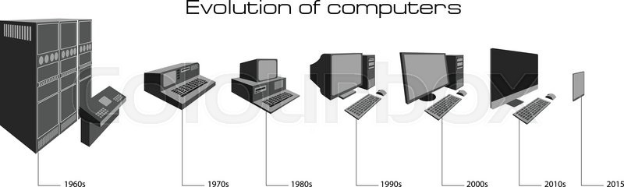
Relevance of DB to company (1)
1. Nowadays, (electronic) data can be easily collected and stored, to form a big data!
2. For companies, they do not lack data—they lack employees who can use the data (or analyzing the data)!
3. Top business schools are gambling the future on business
analytics!
https://d2gg9evh47fn9z.cloudfront.net/800px_COLOURBOX16451556.jpg
Notes:
While we have explained company needs those with a database skills, but why this is the case. Such increasing demand is actually triggered by the fact that currently company can collect more and more data and the cost for hosting and utilizing big data has been substantially reduced. For instance, BI software like Power BI can be purchased at a very low cost. All of these motivated company to recruit people with a capability to utilize and analyze data. That is also why major business topics are implementing business analytic program at different level and so do our school. To utilize company data, the most fundamental tool that I must have is database skill.

Slide 34
Relevance of DB to company (2)
Make unorganized raw data to be organized so that it is ready for analysis.
Most time, raw data cannot be used directly.
It can only be used after being ‘cleaned’ or summarized.
Most time, raw data is too big to be used (e.g., too many unnecessary variables, data are scattered and saved in different tables or places)

Slide 35
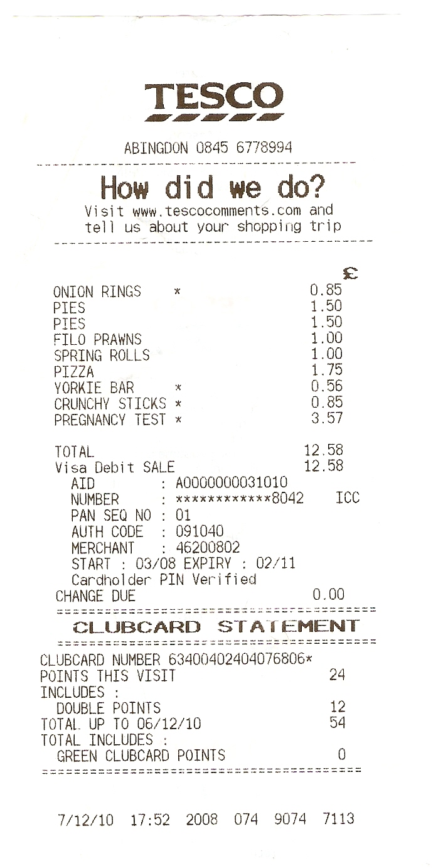
Thinking about this example
1. You have access to the database of a retailing company who operates tens of supermarkets across many cities.
2. You want to investigate the relationship between revenues of individual supermarkets and populations of the residential areas where the supermarkets are located.
https://babygenie.files.wordpress.com/2010/12/scan0002.jpg

Slide 36

A simple comparison between SQL and Excel
 | Excel | SQL
Avoid accidental changes to data
Complexity of vocabulary
Capability to replicate previous analysis
General speed of data manipulation
Access to high computing power
Manipulation of large data files
Calculation capability
Notes:
Human imagination is not unlimited

Slide 37

Relevance of DB to your career (1)
“The Finnish national curriculum takes coding farther than any other European country. In Finland, starting fall 2016, coding is a mandatory, cross curricular activity that starts from first year of school”.
http://www.goodnewsfinland.com/finnish-schoolchildren-develop-coding-for-curriculum/

Slide 38
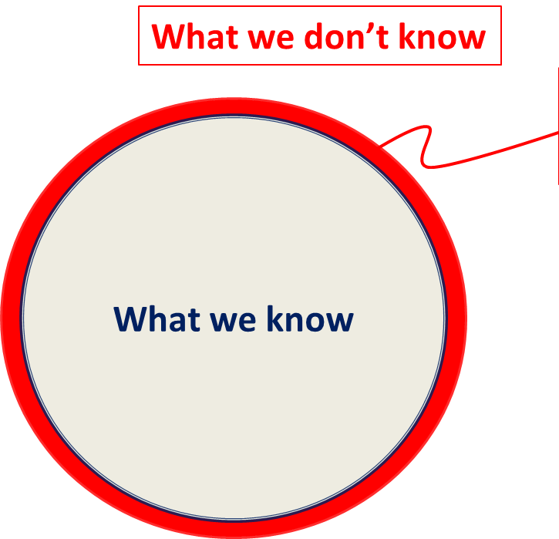
Relevance of DB to your career (2)
An important skill to understand the future business practice.
You will start to see the beauty of programming and to cultivate an analytic mind!
What we can imagine!
Data analysis skill is a catalyst that helps you to push the boundary of your knowledge so
that you can imagine more in
this increasingly data-rich world!

Slide 39

Finally, it is nice to be capable of exploring this world via data!

Slide 40



First Impression on MySQL
Statistic analysis capability
Data manipulation/management capability
Mainly operated through clicking on menu
Mainly operated through writing code

Slide 41
What is database? (e.g., Youtube)
A database is a structured collection of data.
VIDEOS
USER
COMMENTS
Video ID
Video Title
Length
ID of who upload
Time of uploading
Etc.
Name
Age
Gender
Username (user ID)
Password
Video ID
Who comment
When
How many likes
On average, how many ‘likes’ on the videos upload by a user – John, have received?

Slide 42
What is an unstructured collection of data?
User(author) | Gender | Video title | Time of uploading | User(reviewer) | Comments
UserA | Male | MySQL tutorial 1 | 05/05/2022 18:56 | UserB | First comment
UserA | Male | MySQL tutorial 1 | 05/05/2022 18:56 | UserB | Second comment
UserA | Male | MySQL tutorial 1 | 05/05/2022 18:56 | UserC | Third comment
UserA | Male | MySQL tutorial 1 | 05/05/2022 18:56 | UserD | Forth comment
UserA | Male | MySQL tutorial 1 | 05/05/2022 18:56 | UserF | Fifth comment
VIDEOS
USER
COMMENTS
Video ID
Video Title
Length
ID of who upload
Time of uploading
Etc.
Name
Age
Gender
Username (user ID)
Password
Video ID
Who comment
When
How many likes

Slide 43
Importance of database language (an example of Youtube)
Whether females receive more comments/feedbacks on their videos than males do on average?
To answer the above question, you need to:
Find the list of videos uploaded by the users (ID) who specified their gender as female. — table User and Videos
Count the number of comments on the videos that appear in the above list. — table User and Videos and Comments
Count the number of the users (ID) who specified their gender as females — table User
Get the average value for female users (number of comments / number of females)
Repeat the analysis for males.

Slide 44
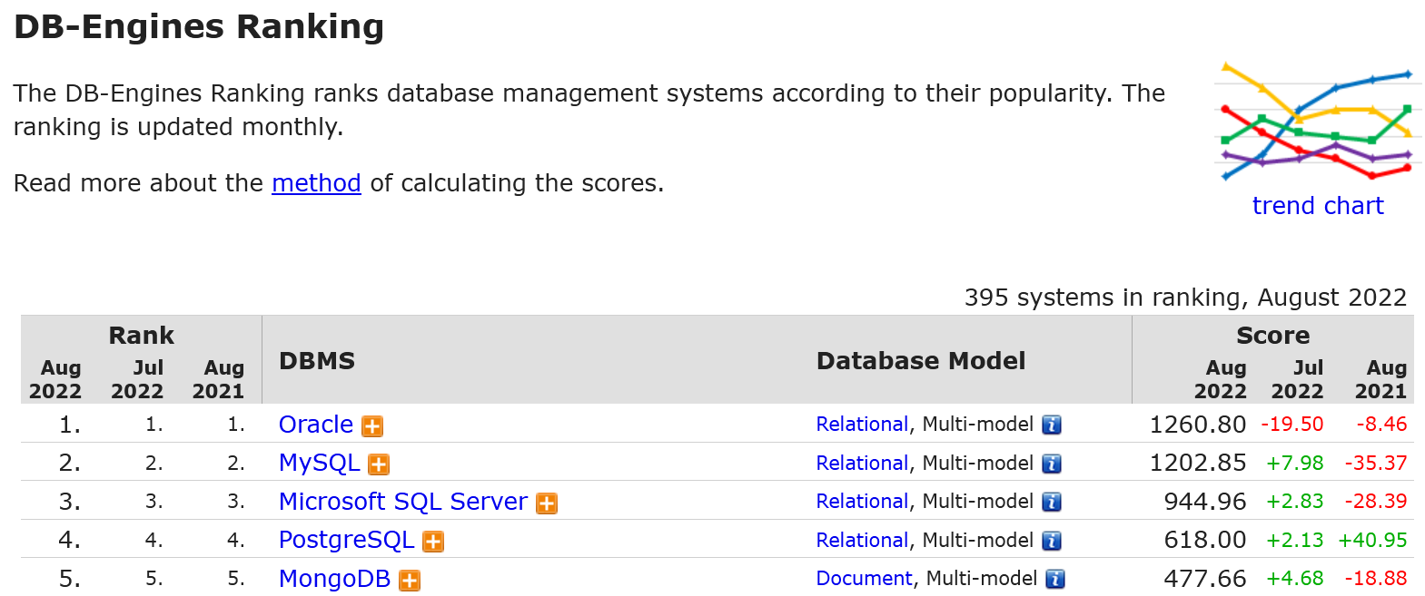
Market share
https://db-engines.com/en/ranking

Slide 45
MySQL and Oracle are similar
Selecting records from the customer table
In MySQL:
SELECT * FROM customer;
In Oracle:
SELECT * FROM customer;
Create a customer database in MySQL: CREATE DATABASE customers; Create a customer database in Oracle: CREATE DATABASE customers;
Updating records in the customer table
In MySQL:
UPDATE customer SET branch="main" WHERE custage > 2;
In Oracle:
UPDATE customer SET branch="main" WHERE custage > 2;
https://blog.panoply.io/mysql-vs-oracle

Slide 46
Database Languages (Oracle vs. MySQL)
Oracle is designed for enterprise customers with a big enough budget and more complex business needs.
MySQL is a lower-cost database that is most used for database-driven websites and non-mission critical applications.
Source from: Jeremy Haubrich, A comparison of MySQL And Oracle, https://www.bus.iastate.edu/mennecke/533/s04/MySQLOracle.ppt
Notes:
In computer science, overhead is any combination of excess or indirect computation time, memory, bandwidth, or other resources that are required to perform a specific task.
mission critical applications: Railway/aircraft operating and control systems

Slide 47
History of MySQL
MySQL was created by a Swedish company, MySQL AB and the first version of MySQL appeared on 23 May 1995.
In January 2008, Sun Microsystems bought MySQL for $1 billion.
In April 2009, Oracle Corporation entered into an agreement to purchase Sun Microsystems, then owners of MySQL copyright and trademark.
Two different editions: the open source MySQL Community Server and the proprietary Enterprise Server.
http://en.wikipedia.org/wiki/MySQL

Slide 48
Key features of MySQL
MySQL is a database management system (DBMS).
To add, access and process data stored in a computer database, we need a database management system such as MySQL server.
The SQL part of “MySQL” stands for “Structured query language”.
2. MySQL databases are relational.
A relational database stores data in separate tables rather than putting all the data in one big storeroom. The database structures are organized into physical files optimized for speed.
You set up rules governing the relationships between different data fields, such as one-to-one, one-to-many, unique between different tables.
Notes:
MySQL is a database management system.
A database is a structured collection of data. It may be anything from a simple shopping list to a picture gallery or the vast amounts of information in a corporate network. To add, access, and process data stored in a computer database, you need a database management system such as MySQL Server. Since computers are very good at handling large amounts of data, database management systems play a central role in computing, as standalone utilities, or as parts of other applications.
MySQL databases are relational.
A relational database stores data in separate tables rather than putting all the data in one big storeroom. The database structures are organized into physical files optimized for speed. The logical model, with objects such as databases, tables, views, rows, and columns, offers a flexible programming environment. You set up rules governing the relationships between different data fields, such as one-to-one, one-to-many, unique, required or optional, and “pointers” between different tables. The database enforces these rules, so that with a well-designed database, your application never sees inconsistent, duplicate, orphan, out-of-date, or missing data.
The SQL part of “MySQL” stands for “Structured Query Language”. SQL is the most common standardized language used to access databases. Depending on your programming environment, you might enter SQL directly (for example, to generate reports), embed SQL statements into code written in another language, or use a language-specific API that hides the SQL syntax.
SQL is defined by the ANSI/ISO SQL Standard. The SQL standard has been evolving since 1986 and several versions exist. In this manual, “SQL-92” refers to the standard released in 1992, “SQL:1999” refers to the standard released in 1999, and “SQL:2003” refers to the current version of the standard. We use the phrase “the SQL standard” to mean the current version of the SQL Standard at any time.
MySQL software is Open Source.
Open Source means that it is possible for anyone to use and modify the software. Anybody can download the MySQL software from the Internet and use it without paying anything. If you wish, you may study the source code and change it to suit your needs. The MySQL software uses the GPL (GNU General Public License), http://www.fsf.org/licenses/, to define what you may and may not do with the software in different situations. If you feel uncomfortable with the GPL or need to embed MySQL code into a commercial application, you can buy a commercially licensed version from us. See the MySQL Licensing Overview for more information (http://www.mysql.com/company/legal/licensing/).
The MySQL Database Server is very fast, reliable, scalable, and easy to use.
If that is what you are looking for, you should give it a try. MySQL Server can run comfortably on a desktop or laptop, alongside your other applications, web servers, and so on, requiring little or no attention. If you dedicate an entire machine to MySQL, you can adjust the settings to take advantage of all the memory, CPU power, and I/O capacity available. MySQL can also scale up to clusters of machines, networked together.
You can find a performance comparison of MySQL Server with other database managers on our benchmark page.
MySQL Server was originally developed to handle large databases much faster than existing solutions and has been successfully used in highly demanding production environments for several years. Although under constant development, MySQL Server today offers a rich and useful set of functions. Its connectivity, speed, and security make MySQL Server highly suited for accessing databases on the Internet.
MySQL Server works in client/server or embedded systems.
The MySQL Database Software is a client/server system that consists of a multi-threaded SQL server that supports different backends, several different client programs and libraries, administrative tools, and a wide range of application programming interfaces (APIs).
We also provide MySQL Server as an embedded multi-threaded library that you can link into your application to get a smaller, faster, easier-to-manage standalone product.

Slide 49
Key component of relational database
Relational database consists of tables.
Table consist of row (records, or observations, samples) and column (attributes, or variables)
Tables are ‘connected’ via foreign key.
Example: Table 1 records user ID, users’ names, age, gender. Table 2 records user ID and users’ videos. Both tables are ‘connected’ by user ID (unique for each user).
Records in a table can have unique identifier—Primary key.

Slide 50
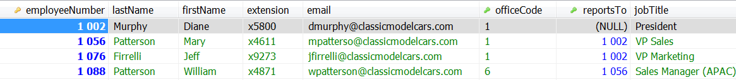
Characteristics of a table
A two-dimensional structure with rows and columns.
Each table must have an attribute to uniquely identify each row [Primary key].
There are no duplicate rows.
Column values all have the same data type.
Order of the rows and columns is immaterial to the DBMS.

Slide 51
Key features of MySQL
MySQL software is Open Source.
Open source: anyone can use and modify the software
Free (community version)
You may change the source code to suit your need.
The MySQL Database Server is very fast, reliable, and easy to use.
MySQL Server works in client/server or embedded systems.
Notes:
It's fast. The main goal of the folks who developed MySQL was speed. Thus, the software was designed from the beginning with speed in mind.
It's inexpensive. MySQL is free under the open source GPL license, and the fee for a commercial license is reasonable.
It's easy to use. You can build and interact with a MySQL database by using a few simple statements in the SQL language, which is the standard language for communicating with RDBMSs. It can run on many operating systems. MySQL runs on many operating systems - Windows, Linux, Mac OS, most varieties of Unix (including Solaris and AIX), FreeBSD, OS/2, Irix, and others.
It's available on almost all Web hosts. If you're going to run your Web site on a Web hosting company, MySQL is widely available without extra cost.
Technical support is widely available. A large base of users provides free support through mailing lists. The MySQL developers also participate in the e-mail lists.
It's secure. MySQL's flexible system of authorization allows some or all database privileges (such as the privilege to create a database or delete data) to specific users or groups of users. Passwords are encrypted.
It supports large databases. MySQL handles databases up to 50 million rows or more. The default file size limit for a table is 4GB, but you can increase this (if your operating system can handle it) to a theoretical limit of 8 million terabytes (TB).
It's customizable. The open source GPL license allows programmers to modify the MySQL software to fit their own specific environments.

Slide 52
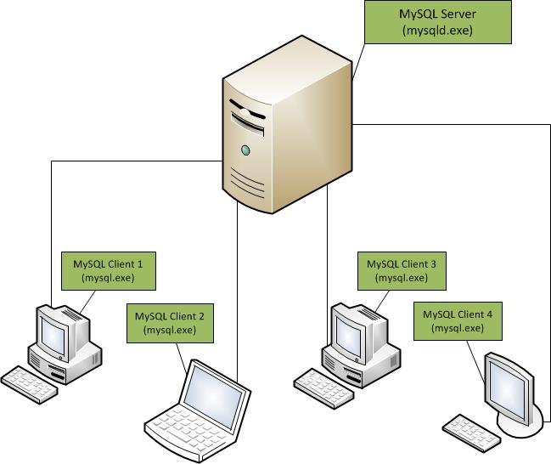
MySQL client/server
Enabling you to take advantages of high-performance computers or servers.
You can also set up a local server in your personal PC.
http://www.duniailkom.com/wp-content/uploads/2012/10/Client-Server.jpg

Slide 53



MySQL client/server - Kill a process
Very often that a command takes hours to operate when using big data. MySQL server will operate the command [e.g., create a new table] from you, irrespective of whether you closed HeidiSQL (or MySQL) from your own computer or not.
A very useful function to free your server from a resource-consuming command sent by you or by other users (if you are an administrator). You can “tell” a server to cancel the command through any computer via your MySQL account.
MySQL
server
1. A worker sends a command to a MySQL server to do a time-consuming task via his/her office computer on Thursday afternoon.
2. S/he checked the status of the command at home via her/his personal computer in the evening, which is not completed.
3. The command is still not completed on Friday morning, so s/he decides to cancel the command to free the server.
https://pixabay.com/vectors/silhouette-programmer-technology-3689661/
https://www.pxfuel.com/en/free-photo-jrhoz

Slide 54
MySQL licensing
Open source license (MySQL Community Edition):
MySQL is available via the GNU Public License (GPL) for no charge.
For instance, if you are using MySQL as a database on a website, MySQL is free for you, even if you are making money with your website.
Commercial license (MySQL Enterprise Edition):
If you use MySQL as a part of a new software product and wants to sell the new product, you needs to purchase a commercial license.

Slide 55
The ‘nature’ of MySQL (personal feeling)
Learning MySQL is like learning a language with 30-50 most common-used vocabulary and a few simple grammars.

Slide 56
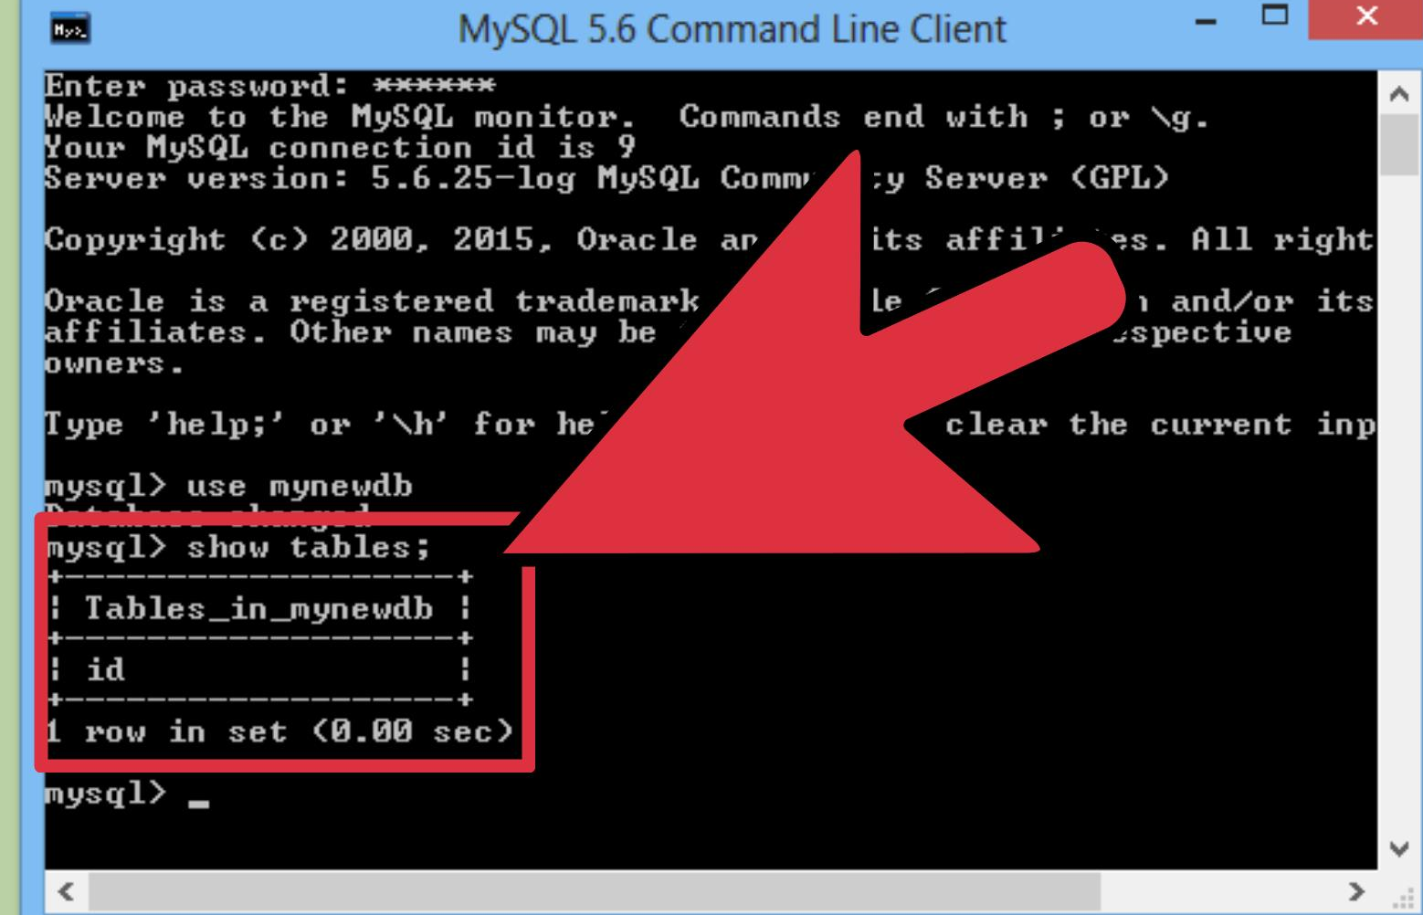
Prerequisites to use MySQL
MySQL
MySQL is available on computers in many of the school’s computer labs and VDI.
MySQL GUI (graphical user interface)
An account to access a MySQL server
An account to access a remote server
A root account: Setup your own computer as a local server
https://www.wikihow.com/Send-Sql-Queries-to-Mysql-from-the-Command-Line

Slide 57
MySQL Graphical User Interface (GUI) tools
Workbench (Free)
Navicat (US$ 149 for Standard edition)
Sequel Pro (Free, Mac OS)
phpMyAdmin (A browser-based tool)
HeidiSQL (This tool is free, which will be used in our course)
A+ (Aalto) ? (cannot change value, add/remove column or build key – not good for beginner)

Slide 58
We have prepared for you…
MySQL has been installed on the computers in several labs.
MySQL database accounts to the remote server have been created for you.
MySQL server can also be used at home via VDI
Instruction on how to use VDI (Virtual Desktop Infrastructure) is available at MyCourse.
MySQL & HeidiSQL has already been installed to your VDI.
You can set up a root account by installing MySQL on your own computer! However, this is actually NOT encouraged.

Slide 59
If you want to install MySQL at your personal computer, it will be your own responsibility to handle the installation errors, because of a lack of labor to deal with these errors.
Reasons: It may take 1 – 3 hours to find the solution to an error (e.g., forgotten password) if lucky.
Facts: MySQL updates every few months while solutions to reset a root password are different for different operating systems.

Slide 60
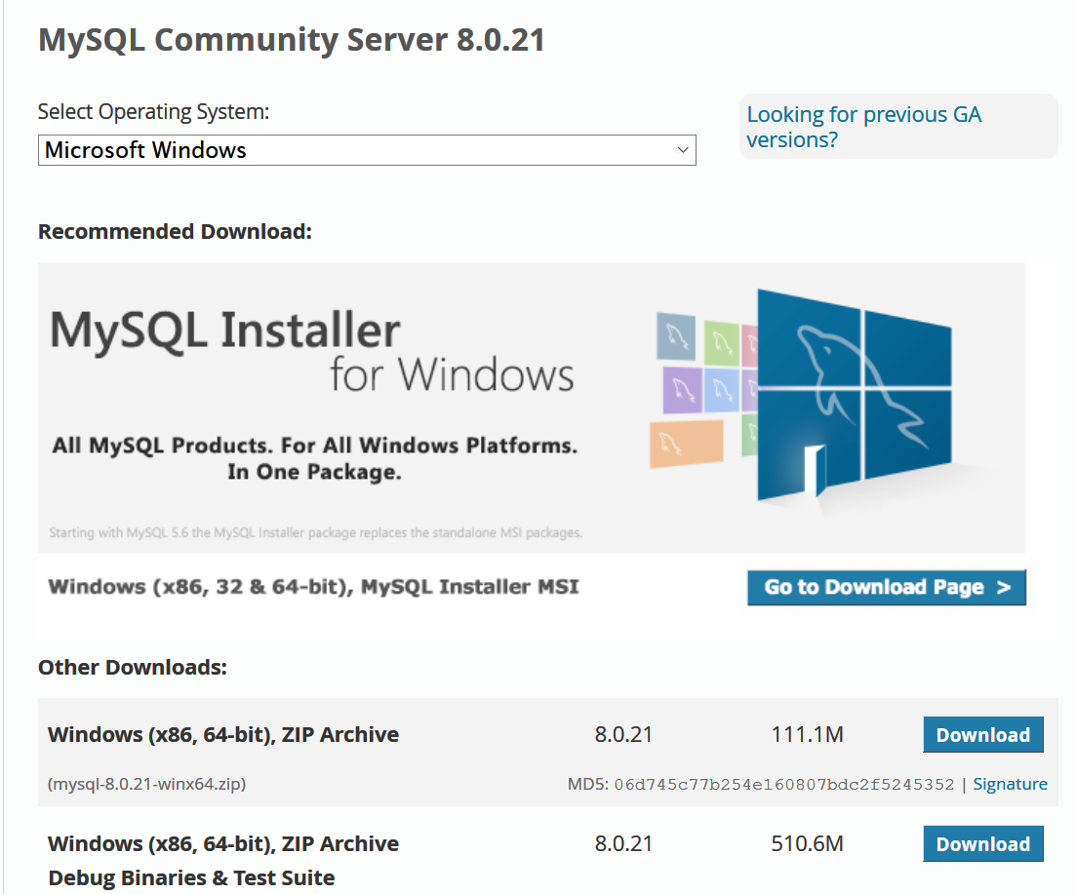
Installation of MySQL community version
Go to: https://dev.mysql.com/downloads/mysql/
How to install: please check more recent Youtube video about how to install MySQL.

Slide 61
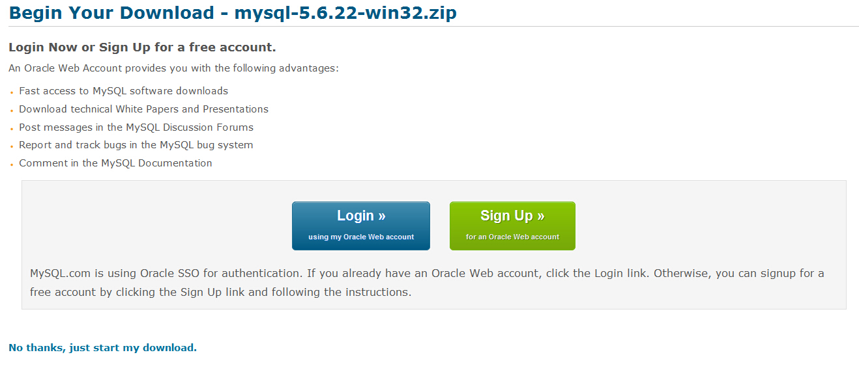
Sign up or not?

Slide 62
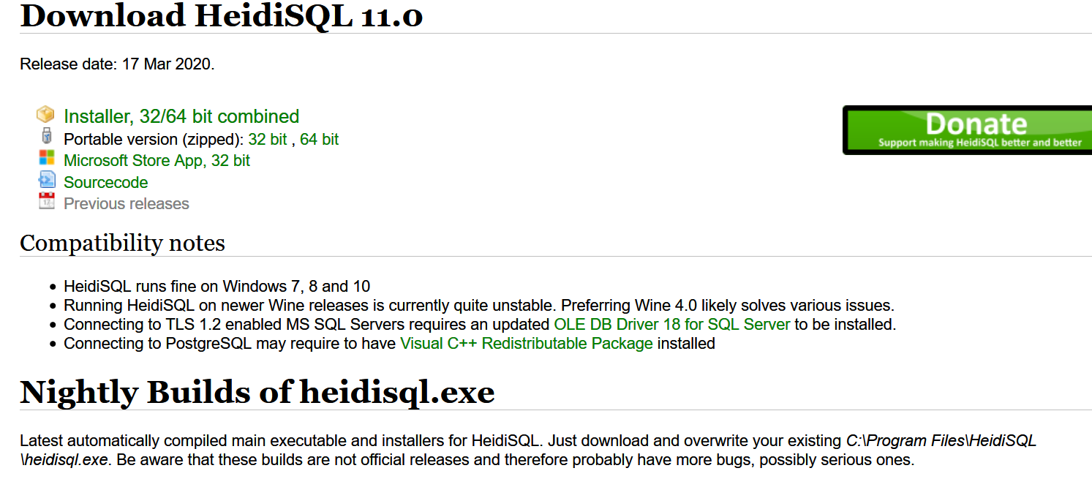
https://www.heidisql.com/download.php

Slide 63

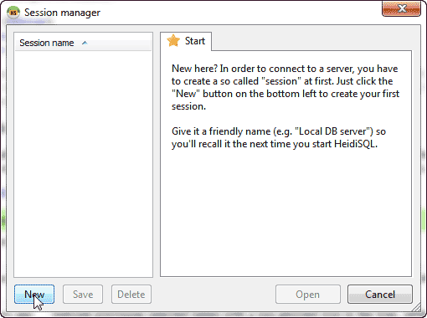
Connecting MySQL server with HeidiSQL
Icon for HeidiSQL
Step 1: Open Heidi SQL.
Step 2: Click New.

Slide 64
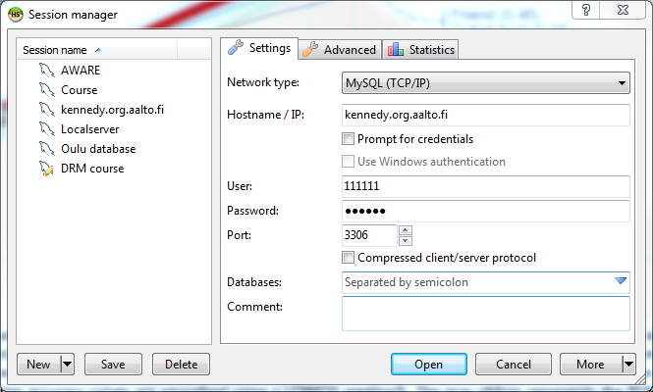
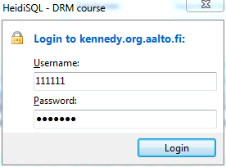
Setup a remote connection
You can access this server via a university computer OR via VDI
Network type: MySQL (TCP/IP). Hostname / IP: johnson.org.aalto.fi
User ID: studentnumber
Password: P + studentnumber
Port: 3306
Databases: Leave as “Separated by Semicolon”
Comment: Leave it blank
Such as: P123456

Slide 65
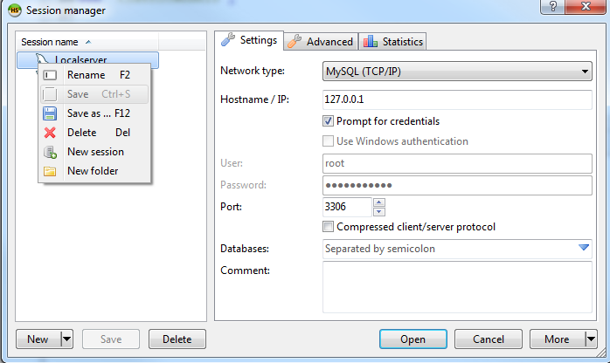
Rename database session

Slide 66
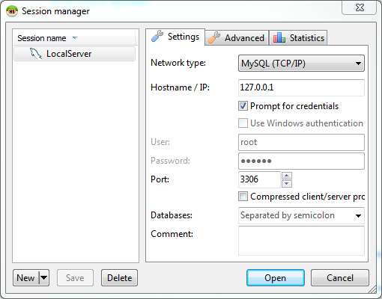
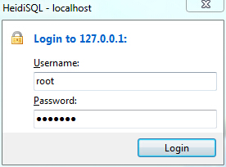
Setup a local server
Local server works, if you have actually installed MySQL to your own computer.
Network type: MySQL (TCP/IP). Hostname / IP: 127.0.0.1
User: root
Password:
Port: 3306
Databases: Leave as “Separated by Semicolon”
Comment: Leave it blank
This is important.

Slide 67
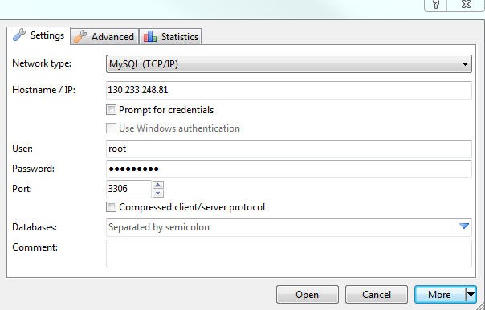
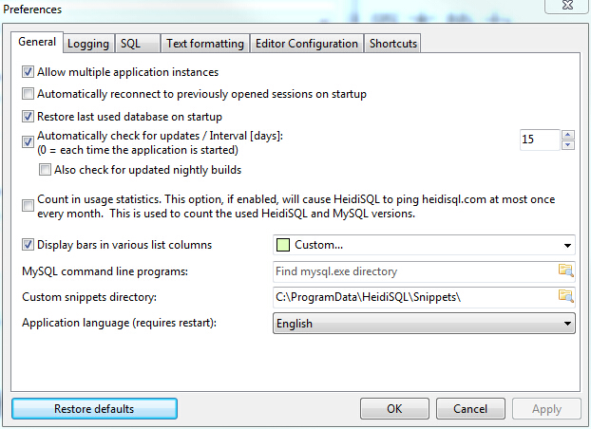
Change interface language
More → Preference

Slide 68
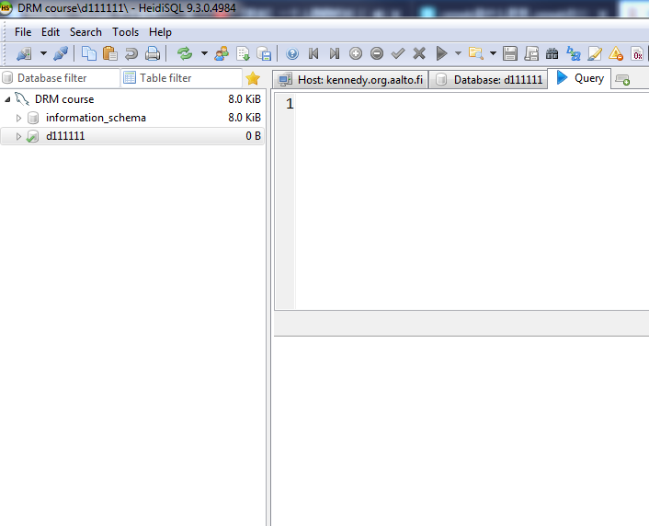
Information_schema is a system database, recording system information. You cannot use this database.
The database named with your student ID is the one that you should use. Left click on the database to activate it so that it becomes a default database for your future operation

Slide 69
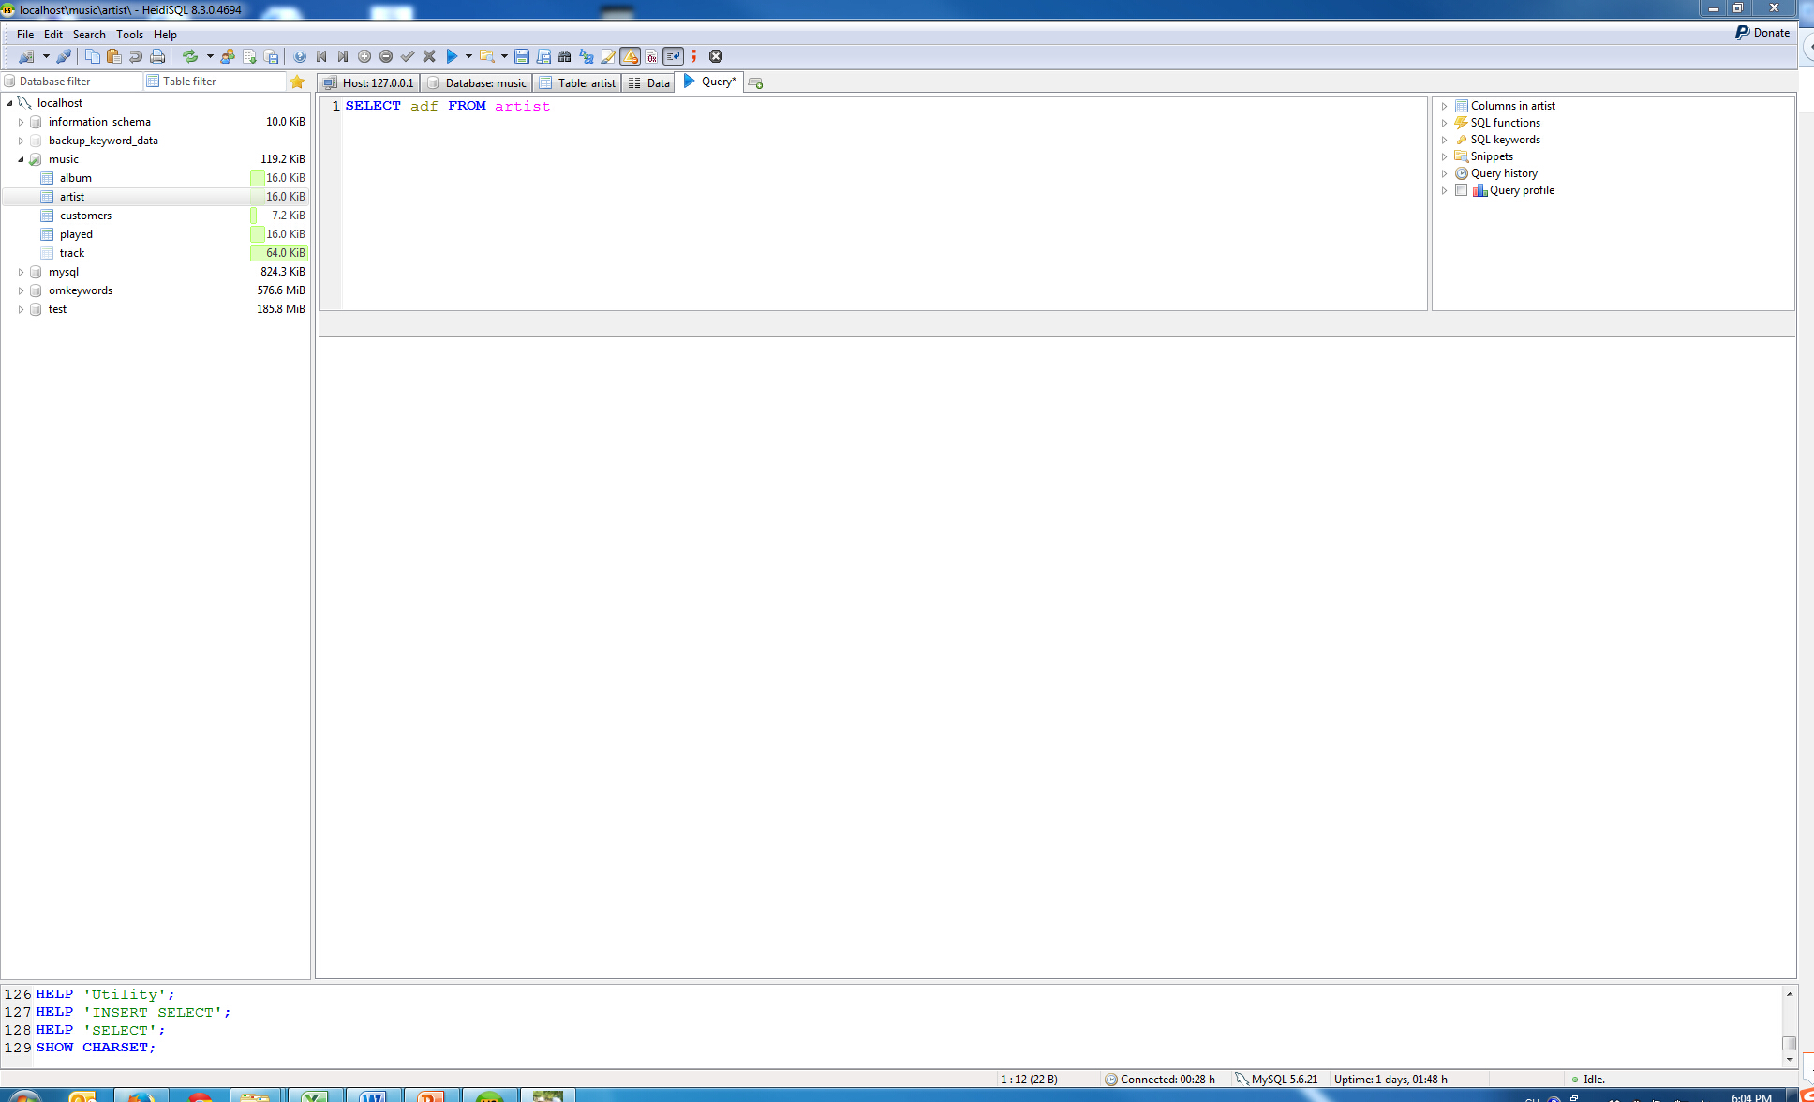
Basic interface of HeidiSQL
Command
History or variable
Database or table
Output
Report

Slide 70
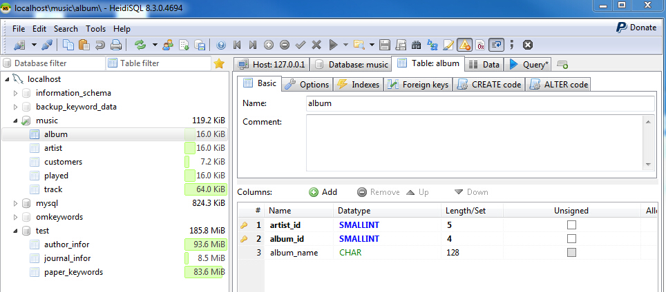
One big advantage of using HeidiSQL.
It will be a good habit to save the command that you used to create tables here.

Slide 71
For the hands-on session
Please read two instructions for hands-on sessions that are available a:t https://mycourses.aalto.fi/course/view.php?id=36995#section-0
Method to access course database server via VDI.docx
Instructions on hands-on session.pdf
Please watch the video on how to import the ‘classicmodels’ database
You can find the database file at: Mycourse → Exercises and database files → Data and database files → classicmodels (using PCs in the lab or at home).sql
Link to the video: https://mycourses.aalto.fi/course/view.php?id=36995&section=3
Please install VDI to your computer and access the MySQL server via VDI (see course homepage for tutorial).
Hands-on learning materials are available on MyCourse
After watching the video, please follow the hands-on learning materials to do the exercise.
Hands-on sessions are simply a venue to offer (question-answering) assistance to support your practice with MySQL.

Slide 72
Denied Access & Late registration
If you registered for the course after August 30, your MySQL account may not yet be created. If your access to the MySQL server is denied, please contact the lecturer to create an account for you by sending your student ID.

